Slide 1


Career Accelerator
Data Science Track
Weekly Session:
Wednesday & Friday: 16:00-18:00 UTC

Slide 2

Agenda
1
Regression Project Introduction (Time Series Forecasting)
2
Project Rubric
3
Timelines

Slide 3
Time Series Forecasting
Scenario: You are a data scientist in Corporation Favorita, a large Ecuadorian-based grocery retailer.
Corporation Favorita want to ensure that they always have the right quantity of products in stock.
To do this you have decided to build a series of machine learning models to forecast the demand of products in various locations.
The marketing and sales team have provided you with some data to aid this endeavor.
Your team uses CRISP-DM Framework for Data Science
projects

Slide 4
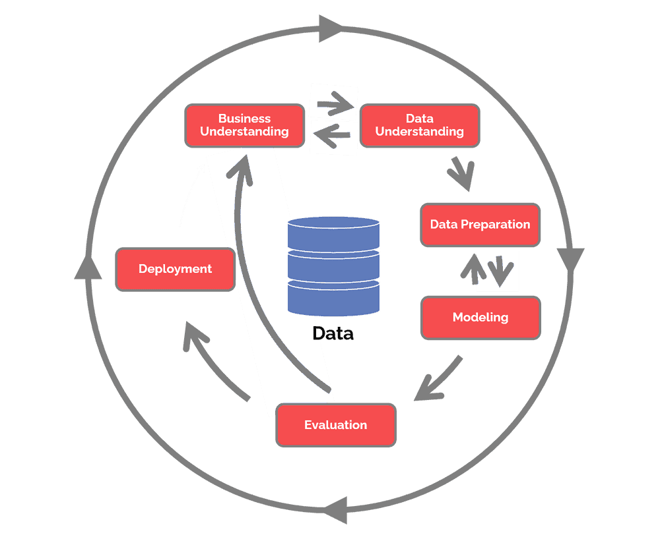
Time Series Forecasting (CRISP-DM)

Slide 5
Time Series Forecasting
Task | Framework Stage
Understanding the problem | Business Understanding
Clean, analyse & visualise the data | Data Understanding
Feature engineering | Data Preparation
Build ML models | Modelling
Evaluate models | Evaluation
Pick optimal model

Slide 6
Project Rubric
Documentation:
Excellent: Having documentation on the project i.e., data cleaning,
analysis, hypothesis and modelling is properly
documented
Good: Gave a summary on some of the processes
Fair: Gave a bullet list of the processes with short sentences
Poor: No documentation

Slide 7
Project Rubric
Hypothesis, Analysis & Visualisation:
Excellent: Validated all hypothesis and answered all questions
listed earlier with appropriate charts. Used relevant
diagrams and charts to show analysis/metrics
Good: Validated at least 4 hypothesis and answered some of the
questions listed with appropriate charts. Used relevant
diagrams but might need some improvements
Fair: Lack of clarity on whether the hypothesis was true
Poor: Not answered any of the hypothesis

Slide 8
Project Rubric
Model Building:
Excellent: Model has an RMSLE of 0.2 or lesser
Good: Model has RMSLE of 0.3 or lesser
Fair: Model has RMSLE of 0.4 or lesser
Poor: Model has RMSLE of 0.4 or greater

Slide 9
Timelines (4 Weeks)
17th January – 12th February
Tuesday, 17th January: Assignment released
Friday, 20th January: Live Coding Session
Tuesday, 24th January: Model Selection
Friday, 27th January: Live Coding Session

Slide 10
Timelines (4 Weeks)
17th January – 12th February
Tuesday, 31st January: Model Evaluation
Friday, 3rd February: Live Coding Session
Tuesday, 7th February: Model Improvement and Future Predictions
Friday, 10th January: Live Coding Session
12th February: Submission deadline

